Slide 1
Data Communications and Networking
Chapter 4
Transmission Media
Reading:
Book Chapter 4
Data and Computer Communications, 8th edition
By William Stallings

Slide 2
Transmission Media
In a data transmission system, the transmission medium is the physical path between transmitter and receiver.
Guided medium
  Electromagnetic waves are guided along a solid medium.
Unguided media
  Wireless transmission occurs through the atmosphere, outer space, or water.
The characteristics and quality of a data transmission are determined both by the medium and the signal.
  For guided media, the medium itself is more important in determining the limitations of transmission.
  For unguided media, the bandwidth of the signal produced by the transmitting antenna is more important. One key property of signals transmitted by antenna is directionality.
Key concerns are data rate and distance: the greater the data rate and distance, the better.

Slide 3
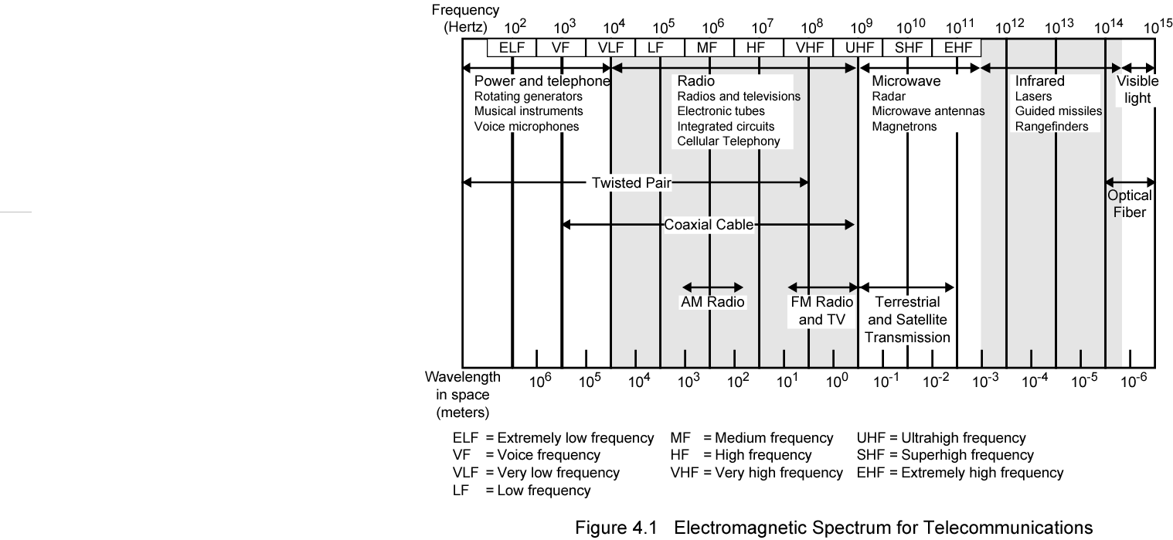
Electromagnetic Spectrum

Slide 4
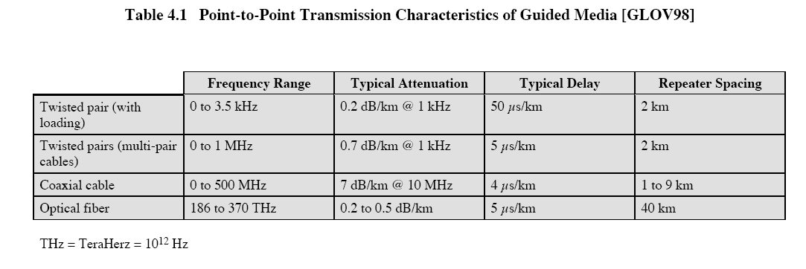
Guided Transmission Media
Twisted Pair
Coaxial cable
Optical fiber

Slide 5
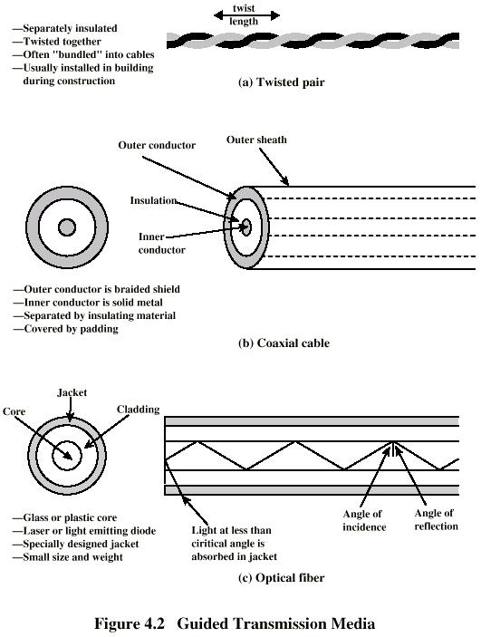
Twisted Pair
A wire pair acts as a single communication link. Typically, a number of these pairs are bundled together into a cable.
The twisting tends to decrease the crosstalk interference between adjacent pairs in a cable, which usually contain hundreds of pairs.

Slide 6
Twisted Pair - Applications
Most common medium
Telephone network
  Individual residential telephone sets are connected to the local telephone exchange (or “end office”) by twisted-pair wire. These are referred to as subscriber loop.
Within an office building
  Each telephone is connected to a twisted pair, which goes to the in-house private branch exchange (PBX) system.
These twisted-pair installations were designed to support voice traffic using analog signaling. However, by means of a modem, these facilities can handle digital data traffic at modest data rates.
For digital signaling: connections to a digital data switch or a digital PBX
For local area networks (LAN)
  Data rates can be around 10Mbps, 100Mbps, or even 1Gbps.

Slide 7
Twisted Pair - Pros and Cons
Pros
  Twisted pair is much less expensive than other commonly used guided transmission media.
  Twisted pair is easier to work with.
Cons: limited in distance, bandwidth, and data rate
  Short range: not good for long-distance
  E.g., the data rate of ADSL depends on the distance
    1.5Mbps for 18,000ft
    2.0Mbps for 16,000ft
    6.0Mbps for 12,000ft
    9.0Mbps for 9000ft

Slide 8
Unshielded and Shielded TP
Unshielded Twisted Pair (UTP)
  Ordinary telephone wire
  Cheapest
  Easiest to install
  Suffers from external electromagnetic interference
UTP categories
  EIA-568-A: Commercial Building Telecommunications Cabling Standard
  Category 3
    The transmission characteristics are specified up to 16MHz
      E.g., the attenuation at 16MHz is about 13db per 100m
    Voice grade found in most offices
    Twist length: 7.5 cm to 10 cm
  Category 5
    The transmission characteristics are specified up to 100MHz
      E.g., the attenuation at 16MHz is about 8db per 100m, the attenuation at 100MHz is about 22db per 100m
    Commonly pre-installed in new office buildings
    Twist length: 0.6 cm to 0.85 cm
  Remark: Category 3 & Category 5 cables are widely used in LAN.
Shielded Twisted Pair (STP)
  Metal braid or sheathing that reduces interference
  More expensive
  Harder to handle (thick, heavy)

Slide 9
Coaxial Cable
Two conductors: outer conductor & inner conductor

Slide 10
Coaxial Cable - Transmission Characteristics
Transmission Characteristics
  Analog signal
    Amplifiers every few km
    Closer if higher frequency
    Up to 500MHz (about 4MHz for each TV channel)
  Digital signal
    Repeater every 1km or so
    Closer for higher data rates
Applications
  Television distribution
    Cable TV
  Long distance telephone transmission
    Can carry 10,000 voice calls simultaneously
    Being replaced by fiber optic
  Local area networks
  Short-range connections between devices such as high-speed I/O channels on computer systems

Slide 11
Optical Fiber

Slide 12
Optical Fiber - Benefits
Benefits
  Greater capacity
    Available bandwidth: about 50THz
    Data rates of hundreds of Gbps
  Smaller size & weight
  Lower attenuation
  Electromagnetic isolation
  Greater repeater (or amplifier) spacing
    10s of km at least
Applications
  Long-haul trunks
    thousands of km
  Metropolitan trunks
    tens of km
  Rural exchange trunks
    hundreds of km
  Subscriber loops
    To replace twisted pair and coaxial cable
  LANs: very high data rate, 100Mbps to 10Gbps

Slide 13
Wireless Transmission Frequencies
Radio is a general term for frequencies in the range of 3kHz to 300GHz. The properties of radio waves are frequency dependent.
30MHz to 1GHz
  Suitable for omnidirectional applications
  E.g., broadcast radio
1GHz to 40GHz
  Referred to as microwave frequencies
  Can be highly directional
  Suitable for point-to-point transmission
  Microwave is also used for satellite communications
3 x 10¹¹ Hz to 2 x 10¹⁴ Hz
  Infrared
  Local applications, such as in a single room
There are national and international agreements about who gets to use which frequencies.
  AM & FM radio, television, mobile phones, telephone companies, police, maritime, navigation, military, government, etc.
  ISM band (Industrial, Scientific, Medical): unlicensed usage
    E.g., Cordless phone, radio-controlled toys, bluetooth, wireless LAN

Slide 14
Antennas
For unguided media, transmission and reception are achieved by means of an antenna.
An antenna is an electrical conductor or system of conductors used either for radiating electromagnetic energy or for collecting electromagnetic energy.
An antenna will radiate power in all directions but does not perform equally well in all directions.
  isotropic antenna: an idealized antenna that radiates power in all directions equally
  antenna gain: a measure of the directionality of an antenna, which is defined as the power output in a particular direction, compared to that produced in any direction by a perfect isotropic antenna.
  Usually, the increased power radiated in a given direction is at the expense of other directions.

Slide 15
Wireless Propagation
Signal radiated from an antenna travels along one of three routes:
  Ground wave
    Follows contour of earth
    Up to about 2MHz
    E.g., AM radio
  Sky wave
    2 to 30 MHz
    Signal reflected from ionosphere layer of upper atmosphere
    Signals can travel thousands of km
    E.g. BBC world service, Voice of America
  Line of sight
    Above 30MHz
    The transmitting and receiving antennas must be within an effective line of sight of each other

Slide 16
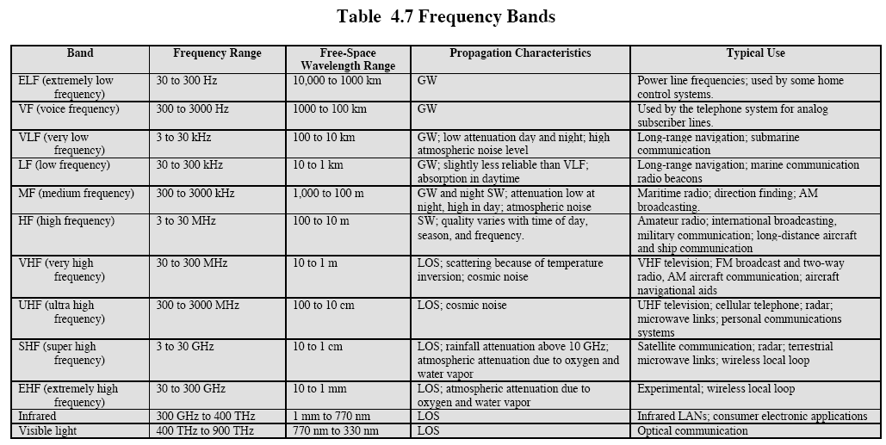
Frequency Bands

Slide 17
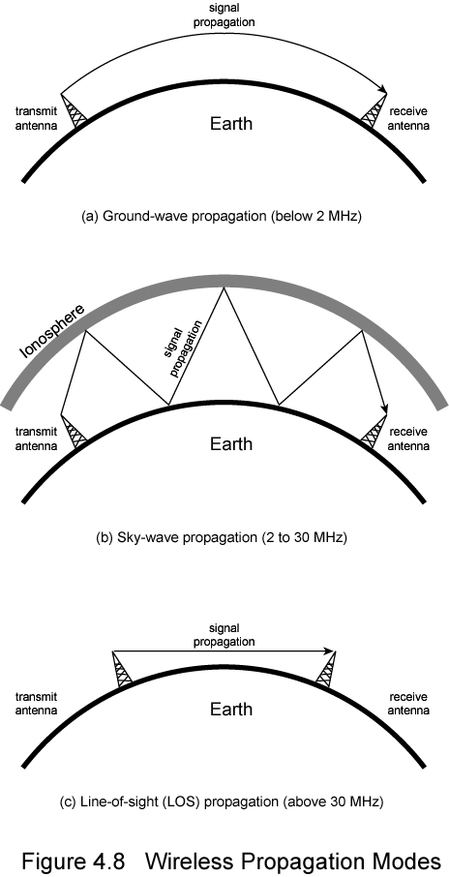
Ground Wave Propagation

Slide 18
Sky Wave Propagation

Slide 19
Line of Sight Propagation

Slide 20
KEY POINTS
The transmission media that are used to convey information can be classified as guided or unguided. Guided media provide a physical path along which the signals are propagated; these includes twisted pair, coaxial cable, and optical fiber. Unguided media employ an antenna for transmitting through air, vacuum, or water.
Traditionally, twisted pair has been the workhorse for communications of all sorts. Higher data rates over longer distances can be achieved with coaxial cable. Today, optical fiber has taken over much of the market for high-speed LANs and for long-distance applications.
Unguided transmission techniques commonly used for information communications include broadcast radio, terrestrial microwave, and satellite.

